Slide 1
Unit 4 – Module 3
Network Security – Symmetric key Encryption
S.Sudha, AP(Sr) / SITE,

Slide 2
Introduction
The term security means protecting the information. Two types of security are,
  Computer security: A collection of tools designed to protect data and to thwart hackers.
  Internet security: Protecting the data during their transmission among the interconnected networks.
S.Sudha, AP(Sr) / SITE,

Slide 3
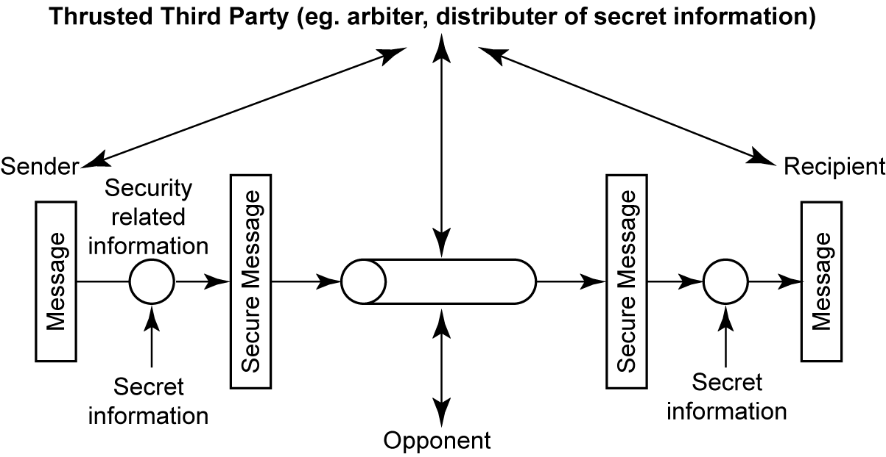
A Model for Network Security
S.Sudha, AP(Sr) / SITE,

Slide 4
Four basic tasks in designing a particular security service are,
  Design an algorithm for performing the security-related transformation. The algorithm should be such that an opponent cannot defeat its purpose.
  Generate the secret information to be used with the algorithm.
  Develop methods for the distribution and sharing of the secret information.
  Specify a protocol to be used by the two principals that makes use of the security algorithm and the secret information to achieve a particular security service.
  A trusted third party may be needed to achieve secure transmission. For example, a third party may be responsible for distributing the secret information to the two principals while keeping it from any opponent
S.Sudha, AP(Sr) / SITE,

Slide 5
CRYPTOGRAPHY
Cryptography comes from the Greek words for “secret writing”.
It is the science and art of transforming messages to make them secure and immune to attacks.
Cryptographic techniques allow a sender to disguise data so that an intruder can gain no information from the intercepted data. The receiver must be able to recover the original data from the disguised data.
S.Sudha, AP(Sr) / SITE,

Slide 6
Basic Terminology
Plaintext - the original message
Ciphertext - the coded message
Cipher - algorithm for transforming plaintext to ciphertext
Key - information used in cipher known only to sender/receiver
Encipher (Encryption) - converting plaintext to ciphertext
Decipher (Decryption) - recovering ciphertext from plaintext
Cryptography - study of encryption principles/methods
Cryptanalysis (codebreaking)- the study of principles/
methods of deciphering ciphertext without knowing key
Cryptology - the field of both cryptography and
cryptanalysis
S.Sudha, AP(Sr) / SITE,

Slide 7
Types of Cryptography
Private-Key Cryptography
Public-Key Cryptography
S.Sudha, AP(Sr) / SITE,

Slide 8
Private-Key Cryptography
Traditional private/secret/single key cryptography uses one key
Shared by both sender and receiver
If this key is disclosed communications are compromised.
Also is symmetric, parties are equal
S.Sudha, AP(Sr) / SITE,

Slide 9

Private-Key Cryptography
S.Sudha, AP(Sr) / SITE,

Slide 10
Public-Key Cryptography
Asymmetric since parties are not equal
public-key/two-key/asymmetric cryptography involves the use of two keys:
  a public-key, which may be known by anybody, and can be used to encrypt messages, and verify signatures
  a private-key, known only to the recipient, used to decrypt messages, and sign (create) signatures
is asymmetric because
  those who encrypt messages or verify signatures cannot decrypt messages or create signatures
S.Sudha, AP(Sr) / SITE,

Slide 11

Public-Key Cryptography
S.Sudha, AP(Sr) / SITE,

Slide 12
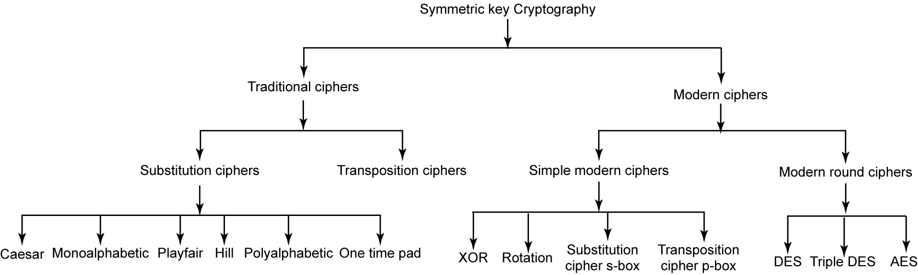
Symmetric key cryptography
S.Sudha, AP(Sr) / SITE,

Slide 13
Traditional ciphers
Substitute Cipher:
  Substitution Technique is one in which letters of plain text are replaced by other letters or by numbers or symbols
Monoalphabetic:
  In a mono-alphabetic cipher, a character (or a symbol) in the plaintext is always changed to the some character (or symbol) in the ciphertext regardless of its position in the text.
  For example, character A in the plaintext is changed to character E, then every character A is changed to character E (one-to-one relationship).
S.Sudha, AP(Sr) / SITE,

Slide 14
  Polyalphabetic:
In a poly-alphabetic ciper, each occurrence of a character in the plaintext can have different substitute in the ciphertext (one-to-many relationship).
For example, character A could be changed to E in the beginning of the text and it could be changed to M at the middle.
  Shift Cipher:
Here assume that the plaintext and ciphertext consist of uppercase letters (A to Z) only. The encryption algorithm is “shift key characters down” with key equal to some number.
In the decryption algorithm is “shift key characters up”. The shift cipher is sometimes referred to as the Caesar cipher.
Example: If the key is 15, the encryption algorithm is shift 15 characters down [towards the end of the alphabet (A to Z)]. The decryption algorithm is shift 15 characters up [towards the beginning of the alphabet (Z to A)].
S.Sudha, AP(Sr) / SITE,

Slide 15
Transposition ciphers:
In a transposition cipher, no substitute of characters but locations will be changed. It involves the rearrangement of the original plain text characters.
Key:
  In a transposition cipher, the key is a mapping between the position of the symbols in the plaintext and the cipher text.
Example: The key for the four characters block are,
Plain text : 3 4 1 2
Cipher text : 1 2 3 4
  In encryption, we move the character at position 3 to position 1, the character at 4 to 2, and so on.
  In decryption, the reverse process will occur.
S.Sudha, AP(Sr) / SITE,

Slide 16
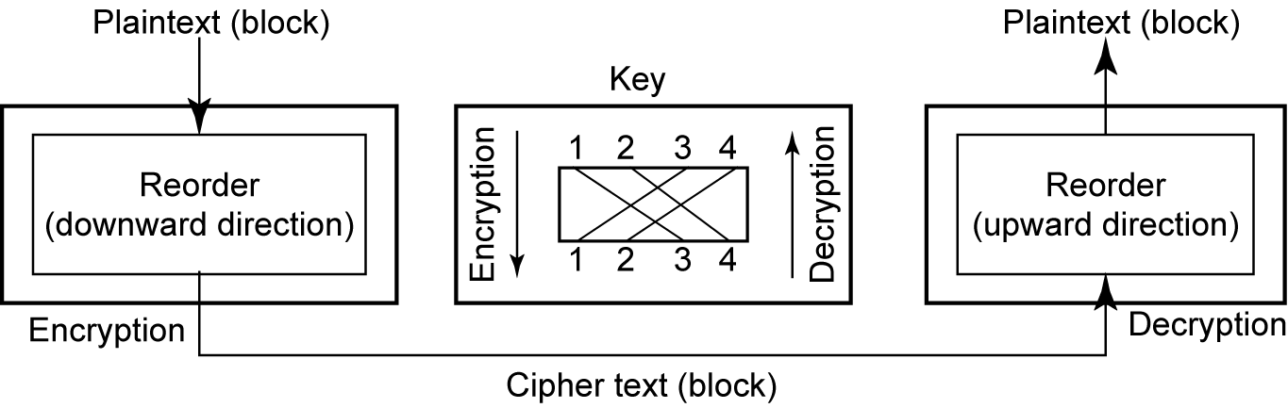
S.Sudha, AP(Sr) / SITE,

Slide 17
  Example of Transposition cipher:
Message: HOW ARE YOU DARLING
Encryption:
Step 1: Divides it into 4 characters block as, (1234)
HOWA REYO UDAR LING
Step 2: Change the position of each block using 3412 as, (3412)
WAHO YORE ARUD NGLI
Thus, encrypted message is WAHOYOREARUDNGLI
Decryption:
Step 1: Divide the cipher text message into blocks
WAHO YORE ARUD NGLI
Step 2: Reorder using the value key 3412 as,
HOWA REYO UDAR LING
Step 3: Combine the block; we get the original message as, HOW ARE YOU DARLING
S.Sudha, AP(Sr) / SITE,

Slide 18
Simple Modern Ciphers
  Modern ciphers:
  A modern symmetric is a combination of simple ciphers.
(i) XOR cipher:
  It is called so, because it uses the exclusive-or operation.
  It needs 2 inputs, 1) Plain text, and 2) Key.
  Here the size of the key, plain text and cipher text are all same
S.Sudha, AP(Sr) / SITE,

Slide 19
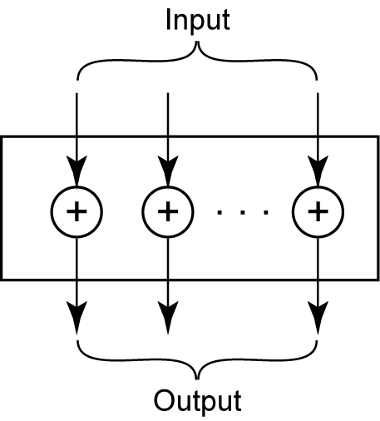
S.Sudha, AP(Sr) / SITE,

Slide 20
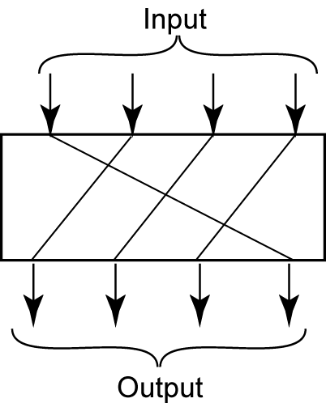
Rotation cipher: In which inputs are rotated left or right to produce encrypted output.
S.Sudha, AP(Sr) / SITE,

Slide 21
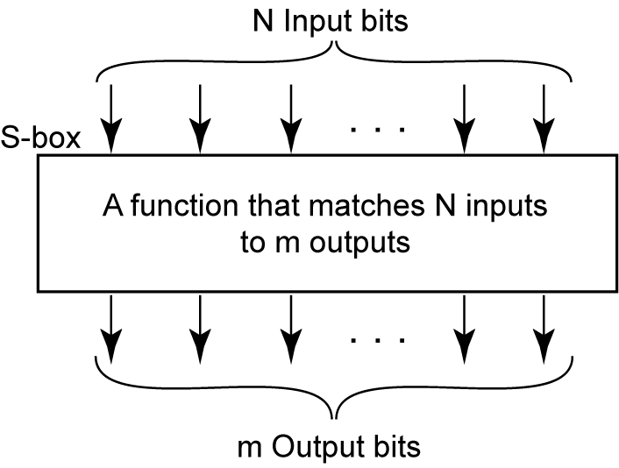
Substitution (S-box) Cipher: The input to an S-box is a stream of bits with length N; the result is another stream of bits with length M.
S.Sudha, AP(Sr) / SITE,

Slide 22
Permutation–box (p-box)
  Three types of permutations are performed in P-boxes.
    Straight permutation
    Expansion permutation and
    Compression permutation.
S.Sudha, AP(Sr) / SITE,

Slide 23
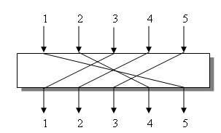
Straight Permutation:
A straight P-box has the same number of inputs (N) as output(N)
S.Sudha, AP(Sr) / SITE,

Slide 24
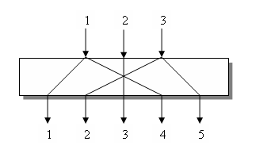
Expansion Permutation
S.Sudha, AP(Sr) / SITE,

Slide 25
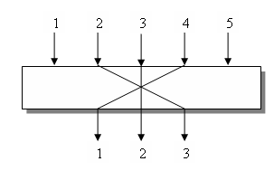
Compression Permutation
S.Sudha, AP(Sr) / SITE,

Slide 26
Modern Round Ciphers
A modern ciphers is usually round ciphers because they involve multiple rounds. Each round is a complex cipher made of a combination of different simple ciphers.
The key used in each round is a subset or variation of the general key called the round key.
If the ciphers has N rounds, a key generator produces N keys, K₁, K₂ …… K_{N}, where K₁ is used in round 1, K₂ in round 2, and so on.
Two modern symmetric-key ciphers are,
  Data Encryption Standard (DES) and
  Advanced Encryption Standard (AES)
S.Sudha, AP(Sr) / SITE,

Slide 27
DES
DES encrypts and decrypts data in 64-bit blocks, using a 64-bit key (although the effective key strength is only 56 bits).
It takes a 64-bit block of plaintext as input and outputs a 64-bit block of ciphertext.
DES has 16 rounds, meaning the main algorithm is repeated 16 times to produce the ciphertext.
It has been found that the number of rounds is exponentially proportional to the amount of time required to find a key using a brute-force attack. So as the number of rounds increases, the security of the algorithm increases exponentially.
S.Sudha, AP(Sr) / SITE,

Slide 28
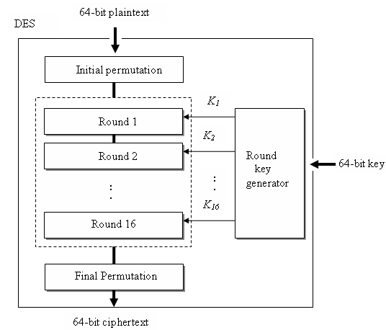
S.Sudha, AP(Sr) / SITE,

Slide 29
DES Encryption
Each stage takes two 32 bits inputs and produces two 32-bits outputs.
During each round, the rightmost 32 bits of the input are moved to the left 32 bits of the output.
The left output is simply a copy of the right input. The right output is the bitwise XOR of the left output and a function of the right input and the key for this stage, K_{i} .
S.Sudha, AP(Sr) / SITE,

Slide 30
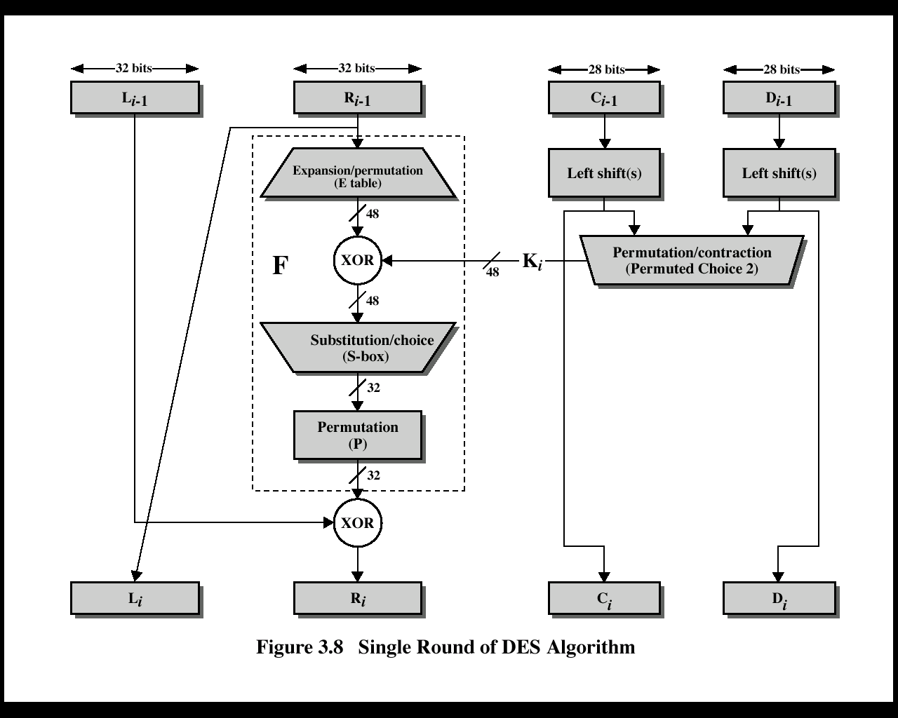
DES Round Structure
S.Sudha, AP(Sr) / SITE,
Notes:
Stallings Fig 3.8
Note that the s-boxes provide the “confusion” of data and key values, whilst the permutation P then spreads this as widely as possible, so each S-box output affects as many S-box inputs in the next round as possible, giving “diffusion”.
Dashed box is not a permutation of the input 32 bits; it is complex crud that gets added in L_{i-1}.

Slide 31
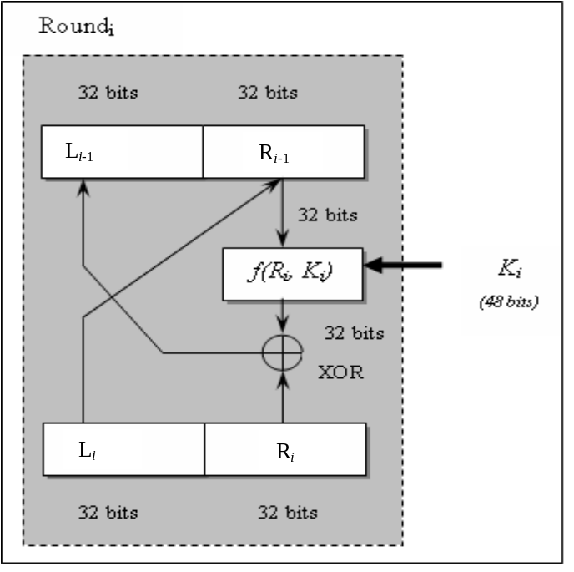
DES Decryption
S.Sudha, AP(Sr) / SITE,

Slide 32
Decryption works by reversing the algorithm’s operations.
When longer messages are encrypted, DES is often used with a technique known as cipher-block chaining.
S.Sudha, AP(Sr) / SITE,

Slide 33
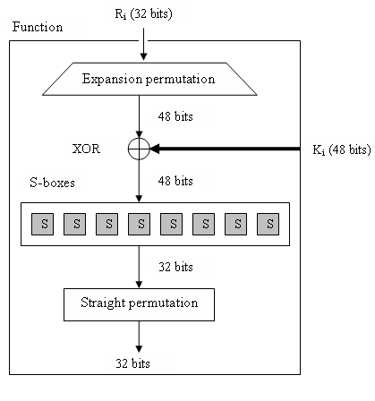
S.Sudha, AP(Sr) / SITE,

Slide 34
Triple DES
In order to lengthen the key of DES, Triple DES or 3DES has been proposed and implemented. Since, normal DES is insecure, triple DES is used.
Two versions of 3DES are,
  3DES with 2 keys, and
  3DES with 3 keys
For the key size of 112 bits, 3DES with 2 keys are used. 3DES with 3 keys are used to increase the key size to 168bits.
S.Sudha, AP(Sr) / SITE,

Slide 35
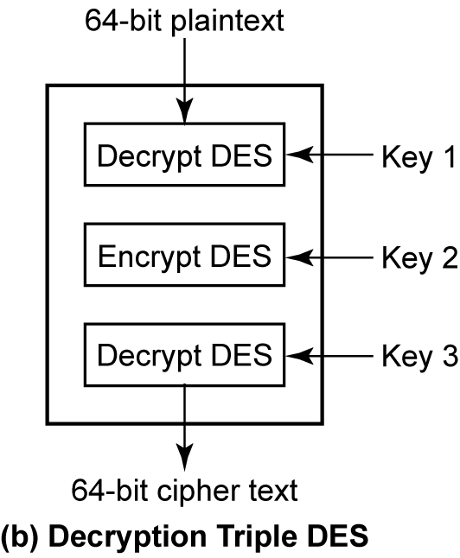
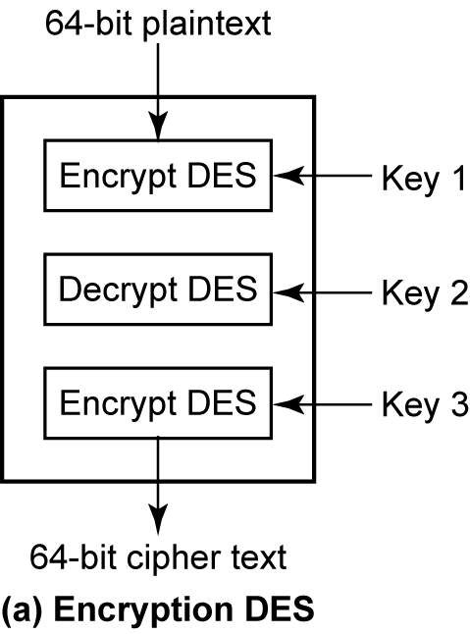
S.Sudha, AP(Sr) / SITE,

Slide 36
Advanced Encryption Standard (AES)
Introduction:
  The AES was designed because DES’s key was too small. In Triple DES key size was increased but the process was too slow.
  In November 2001, NIST (National Institute Standards and Technology) announced the successor to DES called AES.
  It is a symmetric key algorithm that processes data in 128-bit blocks and can operate with keys that are 128, 192 & 256 bits long. AES is a very complex round cipher.
  AES has 3 different configurations with respect to the number of rounds and key size. It is given as,
S.Sudha, AP(Sr) / SITE,

Slide 37
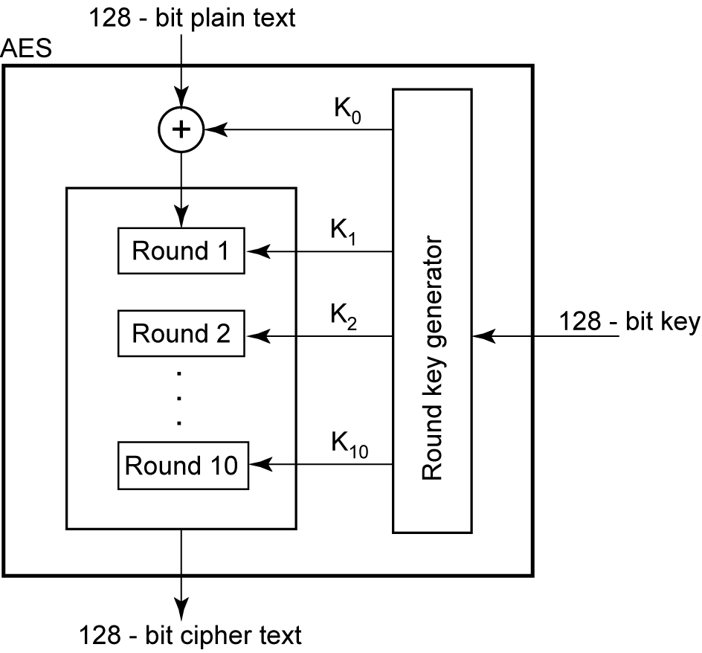
The structure and operation of all configurations are same, but the difference only in their key sizes.
S.Sudha, AP(Sr) / SITE,

Slide 38
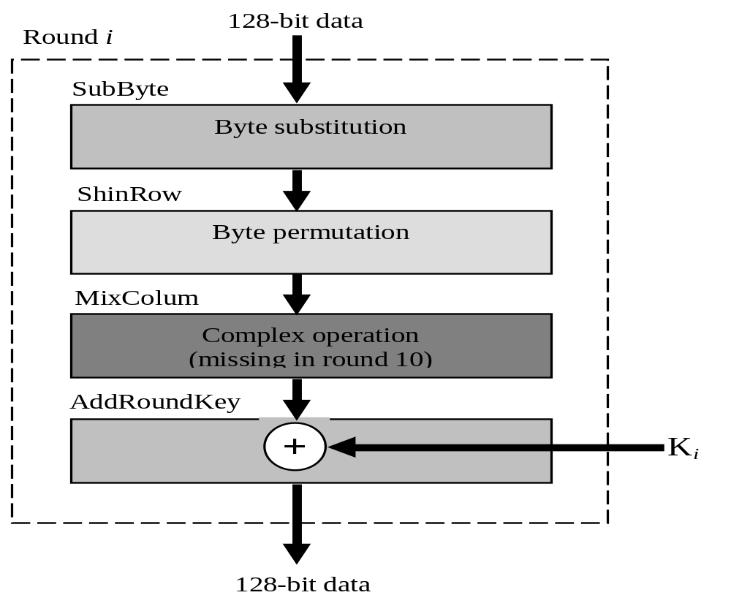
Structure of Each round
S.Sudha, AP(Sr) / SITE,

Slide 39
DES function
The DES function applies a 48-bit key to the rightmost 32 bits R_{i} to produce a 32-bit output.
The DES function contains four operations:
  XOR
  Expansion permutation
  Group of S-boxes and
  Straight permutation.
S.Sudha, AP(Sr) / SITE,

Slide 40
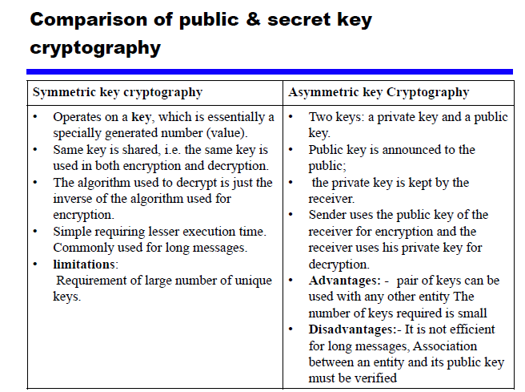
S.Sudha, AP(Sr) / SITE,

